Slide 1
Clustering
Name – Rimo Ghosh
University – Kiit University

Slide 2
KMeans
Dataset used – Mall Customer Segmentation Data
Description - Consider You own a supermarket mall and through membership cards , you have some basic data about your customers like Customer ID, age, gender, annual income and spending score. Spending Score is something you assign to the customer based on your defined parameters like customer behavior and purchasing data.
Problem Statement – You own the mall and want to understand the customers like who can be easily converge [Target Customers] so that the sense can be given to marketing team and plan the strategy accordingly.

Slide 3
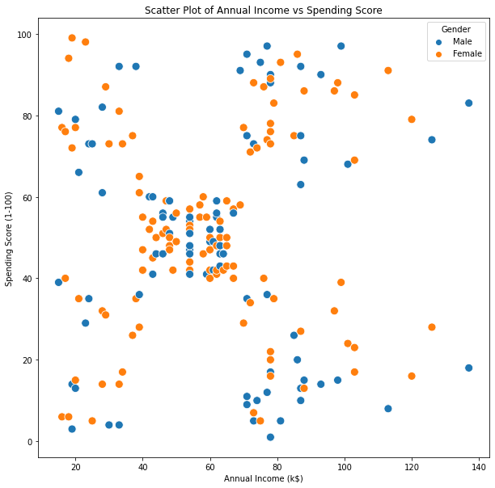
Preprocessing the dataset
From the plot it is clear that there is a correlation between Annual income and Spending score and we can cluster it into segments.
The scatterplots of male and female almost overlap , so there is no need to take into count the genders.
We take Age , Spending Score and Annual Income as the parameters for clustering.

Slide 4
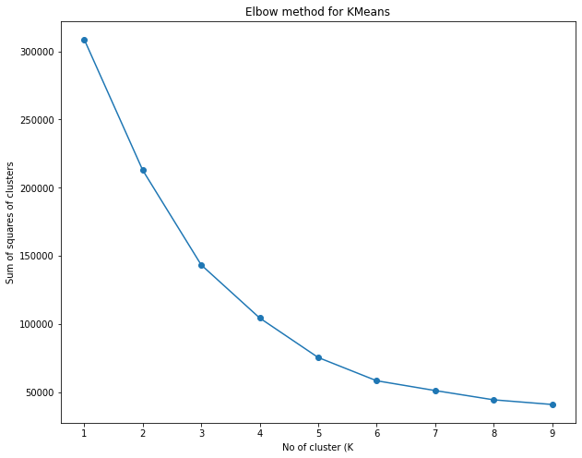
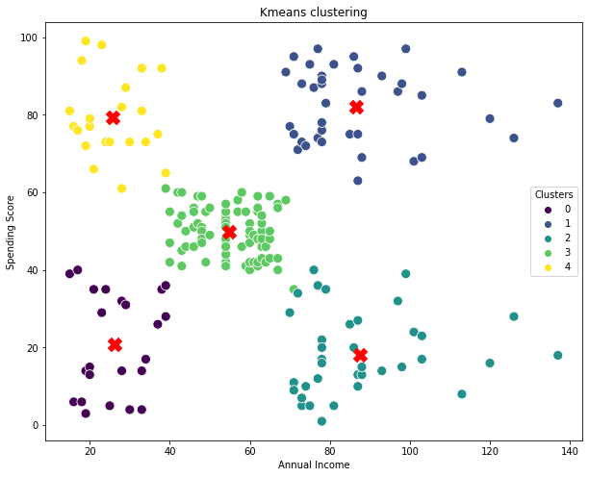
Plotting sum of squares vs no of squares ( also called as inertia ) gives us an elbow shaped curve.
The graph starts almost flatting out when K = 5
Therefore we choose the number of clusters as 5
For k = 5
SI index = 0.444
DBI index = 0.82

Slide 5
Inference
Cluster 0 customers have low annual income and thus low spending scores, since its reasonable that people with low salaries tend to buy less. They tend to save more and save on the needless stuff . The mall shouldn’t concern themselves more with this cluster of people and focus on the rest.
Cluster 4 customers(yellow) although have low income they tend to buy products and thus have more Spending Score. Maybe these cluster of people are more satisfied with the mall services (e.g. discounts on items. The shops/malls might not target these people, but still they can’t lose them
Cluster 3 (Green) indicates that these have average income and have average spending scores. The mall needs to take into account of other things to increase the spending scores of these customers by providing more flexible facilities.
Cluster 1 people are having higher annual income and tend to spend more. They are the mall’s primary targets and cannot compromise on losing them. They might also be regular customers of the mall and are satisfied with the malls facilities.
Cluster 2 people although have higher income , they tend to spend less in this mall. Maybe they are unsatisfied with the malls services and have other places to buy from. The mall should take all the measures to increase their spending score as they have the potential for their profits.

Slide 6
Final Conclusion
Finally, based on our machine learning technique of KMeans clustering, we may deduce that, primarily we have 5 categories of people visiting the mall , and to increase the profits of the mall, the mall authorities should target people belonging to cluster 2 and cluster 3 and should also maintain its standards to keep the people belonging to cluster 4 and cluster 1 happy and satisfied.

Slide 7
Hierarchical Clustering
Dataset used – Online Retail Transactional Dataset
Description - Online retail is a transactional data set which contains all the transactions occurring between 01/12/2010 and 09/12/2011 for a UK-based and registered non-store online retail. The company mainly sells unique all-occasion gifts. Many customers of the company are wholesalers..
Problem Statement – We will be using the online retail transactional dataset to build a Hierarchical clustering and choose the best set of customers which the company should target..

Slide 8
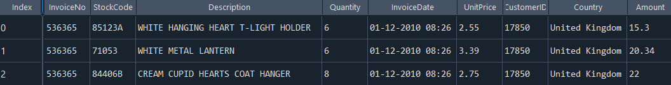
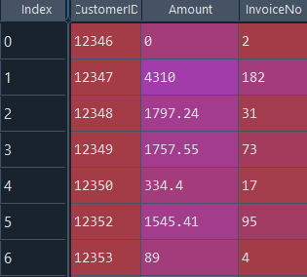
Preprocessing the dataset
The dataset consists of Columns like Description , Country etc. which increases the dimentionality of the data. Thus we try to extract some meaningful insights from the dataset
We are going to cluster the customers based by combining them on the following two factors
1- total amount from each individual customer (Quantity * unit Price)
2- frequency of invoice grouped against each customer
Also we have a large number of outliers. We’ll be using Interquartile range for removal of outliers.
Final Dataset after extracting all meaningful insights

Slide 9
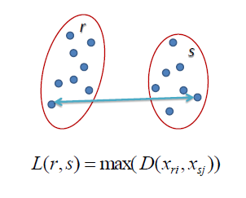
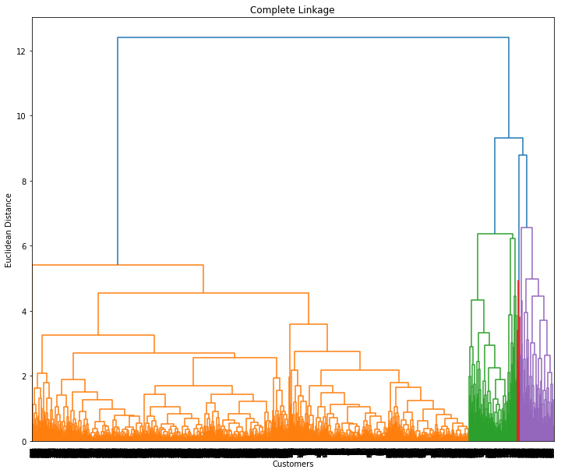
Complete Linkage
In complete hierarchical linkage the distance between two clusters is defined as the longest distance between two points in the two clusters.

Slide 10
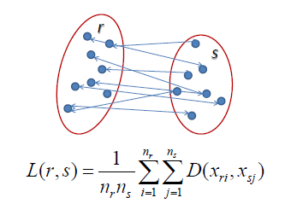
Average Linkage
In average hierarchical linkage the distance between two clusters is defined as the average distance between one point in one cluster to every point in other cluster.

Slide 11
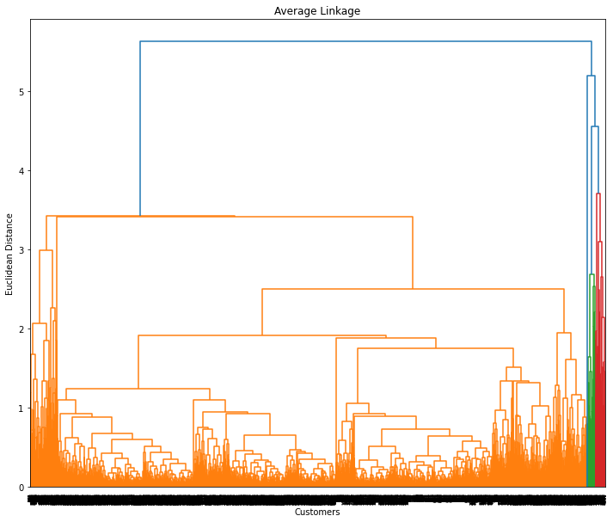
Analyzing the metrics
For k = 2
DBI Index = 0.956
SI Index = 0.576
For k = 3
DBI Index = 0.8266
SI Index = 0.566
For k = 4
DBI Index = 1.011
SI Index = 0.290
Higher the Silhouette Index and lower the DBI Index, more the clustering is better. Thus choosing k = 3 seems more feasible.

Slide 12
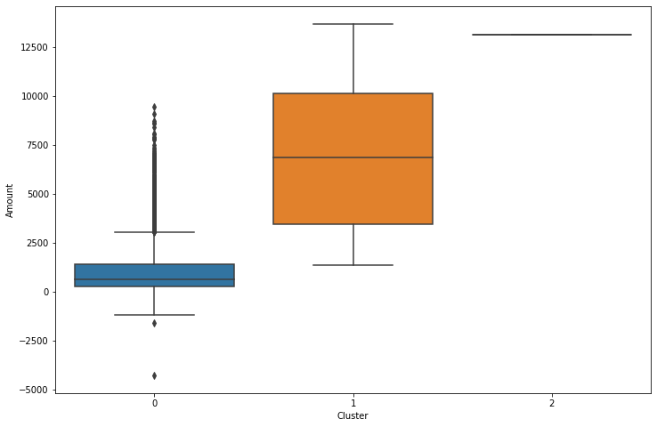
Inference
Customers with cluster id 0 have quite a small median value of amount. Also this cluster of people have more number of outliers, from the maximum value, indicating some people from this cluster than contribute to their profits. The mall shouldn’t overlook them entirely.
Customers with cluster id 1 have higher amount . Therefore they are the prime target customer for the mall.
Cluster 3 customers even though very negligible spend higher amount as compared from cluster2. They must be the few wealthy people and the mall should take these people into consideration.

Slide 13
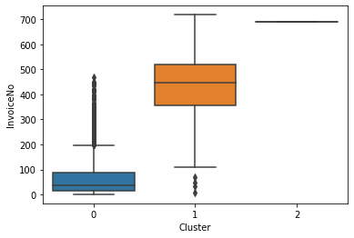
Customers with cluster id 0 have quite a small median value of transaction frequency and have large number of outliers, from the maximum value, indicating some people from this cluster shop more. The mall can’t overlook them entirely.
Customers with cluster id 1 have higher transactional frequency. Therefore they are the prime target customer . One important observation is that some outliers are present from the minimum data value indicating they are not frequently shopping.
Cluster 3 people belong to the wealthy few .

